Slide 1
Welcome to my presentation
Name: Sagor Ray
ID: 20191135010

Slide 2
Topics
Market Structure
Perfect Competition
Monopoly Structure
Duopoly Structure
Oligopoly Structure

Slide 3
What is Market Structure?
The Market Structure refers to the characteristics of the market either organizational or competitive, that describes the nature of competition and the pricing policy followed in the market. Thus, the market structure can be defined as, the number of firms producing the identical goods and services in the market and whose structure is determined on the basis of the competition prevailing in that market.

Slide 4
Type of market structure influences how a firm behaves
Pricing
Supply
Barriers to Entry
Efficiency
Competition

Slide 5
Perfect Competition
Free entry and exit to industry
Homogenous product – identical so no consumer preference
Large number of buyers and sellers – no individual seller can influence price
Sellers are price takers – have to accept the market price
Perfect information available to buyers and sellers

Slide 6
Conditions for Perfect Competition
There are four condition for perfect competition:
Many Buyers and Sellers
Identical Products
Informed Buyers and Sellers
Free Market Entry and Exit

Slide 7
Advantages of Perfect Competition
High degree of competition helps allocate resources to most efficient use
Price = marginal costs
Normal profit made in the long run
Firms operate at maximum efficiency
Consumers benefit

Slide 8
What happens in a competitive environment?
New idea? – firm makes short term abnormal profit
Other firms enter the industry to take advantage of abnormal profit
Supply increases – price falls
Long run – normal profit made
Choice for consumer
Price sufficient for normal profit to be made but no more!

Slide 9
Market equilibrium in perfect competition
Supply
Equilibrium Price
Price
Equilibrium Quantity
Demand
Quantity

Slide 10
Imperfect or Monopolistic Competition
Many buyers and sellers
Products differentiated
Relatively free entry and exit
Each firm may have a tiny ‘monopoly’ because of the differentiation of their product
Firm has some control over price
Examples – restaurants, professions – solicitors, etc., building firms – plasterers, plumbers, etc.

Slide 11
Monopoly- Market Structure
High barriers to entry
Firm controls price OR output/supply
Abnormal profits in long run
Possibility of price discrimination
Consumer choice limited
Prices in excess of MC

Slide 12
Advantage of monopoly
May be appropriate if natural monopoly
Encourages R&D
Encourages innovation
Development of some products not likely without some guarantee of monopoly in production
Economies of scale can be gained – consumer may benefit

Slide 13
Disadvantage of monopoly
Exploitation of consumer – higher prices
Potential for supply to be limited - less choice
Potential for inefficiency – X-inefficiency – complacency over controls on costs

Slide 14
Price
Kinked Demand Curve
£5
D = elastic
Kinked D Curve
D = Inelastic
100

Slide 15
What Is a Duopoly?
A duopoly is a situation where two companies together own all, or nearly all, of the market for a given product or service. A duopoly is the most basic form of oligopoly, a market dominated by a small number of companies. A duopoly can have the same impact on the market as a monopoly if the two players collude on prices or output.

Slide 16
Duopoly- market structure
Industry dominated by two large firms
Possibility of price leader emerging – rival will follow price leaders pricing decisions
High barriers to entry
Abnormal profits likely

Slide 17
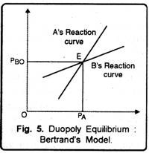

Slide 18
Oligopoly- market structure
Examples of oligopolistic structures:
Supermarkets
Banking industry
Chemicals
Oil
Medicinal drugs
Broadcasting

Slide 19
Measuring Oligopoly
Concentration ratio – the proportion of market share accounted for by top X number of firms:
E.g. 5 firm concentration ratio of 80% - means top 5 five firms account for 80% of market share
3 firm CR of 72% - top 3 firms account for 72% of market share

Slide 20
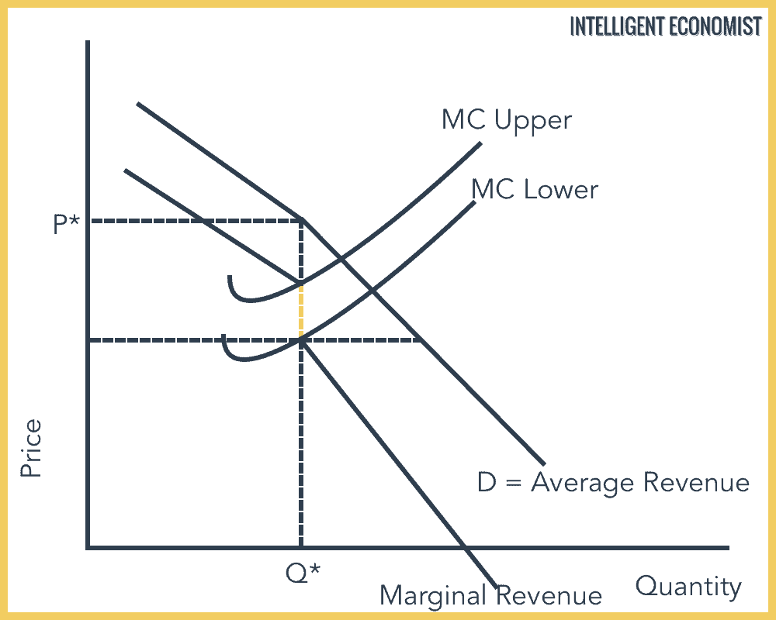
Graph for oligopoly market structure

Slide 21
The end
Thank you

